Slide 1
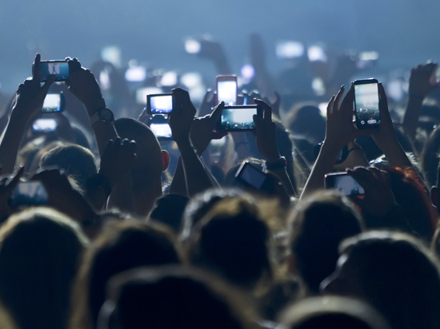

Social Technologies to Change and
Predict Health Behavior
Sean D. Young, PhD, MS
UC Institute for Prediction Technology
National Frontier and Rural (NFAR) ATTC Summit
Notes:
The talk will be entitled, 'Social technologies and social data to change and predict health behavior.' I'll give an overview of current work using mobile and social technologies to change behavioral/mental health with specific examples from our recent studies on HIV and addiction medicine. I'll also give an overview of how social technology data can be used to predict patient behaviors and outcomes

Slide 2
Funding
NIH
UCOP
Facebook
Intel/Basis

Slide 3

https://youtu.be/sZk4vqYd7-Y
Notes:
What’s the current state of mobile/wearable digital interventions for health or substance abuse prevention? There are exciting things going on in this area, for example this breathing coach wearable app - click the video link

Slide 4
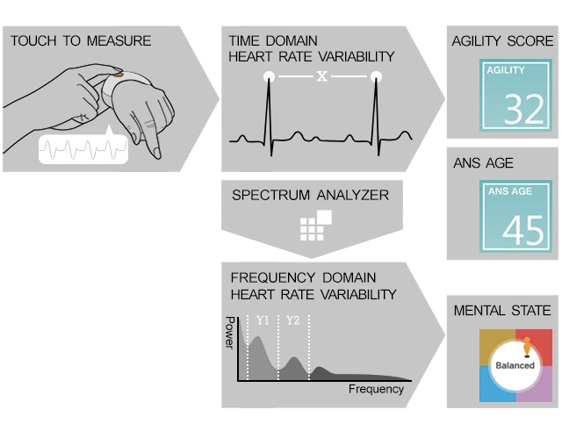
Notes:
How does it work? It combines all these factors into a complete picture, filling in the gaps of other trackers

Slide 5
objectives
Overview of technologies for behavioral and mental health
Application of technologies for substance abuse
Example of HOPE Intervention
Evidence based approach to behavior change

Slide 6


https://youtu.be/cm12OxC7ZXY
Notes:
There are a lot of new and fascinating ideas in this area. This one focuses on youth and athletics and concussion prevention and treatment but there are a lot of potential uses for emerging tech to benefit, change and impact lives and wellbeing

Slide 7
Notes:
AdhereTech smart wireless pill bottles are currently being used by patients in pharmaceutical and research engagements. These bottles collect and send all adherence data in real-time. The system automatically analyzes this information and populates the data on our secure dashboard. If doses are missed, patients can receive customizable alerts and interventions - using automated phone calls, text messages, and more

Slide 8
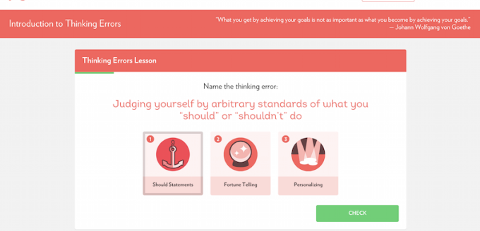
Notes:
This is Joyable and it uses CBT to help their users with social anxiety. They have solid clinical people on their advisor board and it’s a 12 week program. also connects users to a personal coach via text or phone for the program. users report a 90% success rate so far

Slide 9
Notes:
There are some online resources for opioid dependence but they’re part of larger interventions as sort of a side bonus

Slide 10



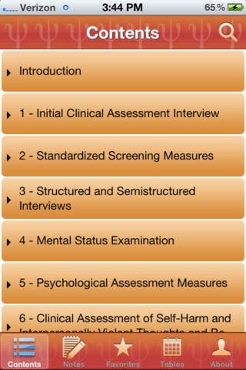
Notes:
There are also resources from the clinical side that are more regulated:
PsycEssentials
By American Psychological Association PsycEssentials is a comprehensive pocket resource for busy psychotherapists. It provides quick and easy access to the key information you need when working with a client. If you are looking for an appropriate assessment tool, state-by-state referral resources, or information on a psychotropic drug, you will find it here. Beyond checklists and links, the app

Slide 11
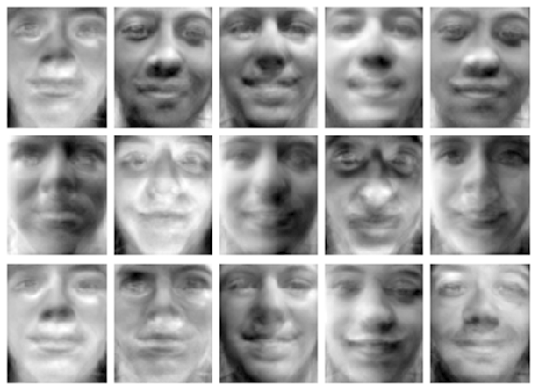
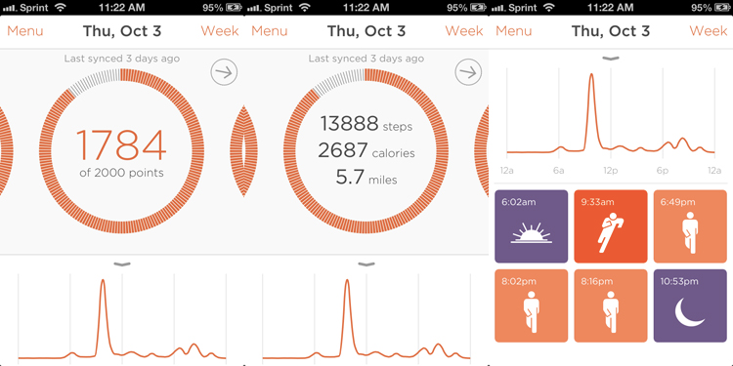
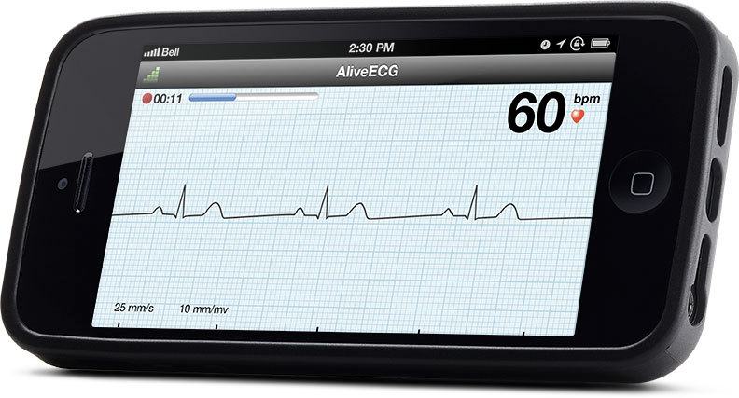
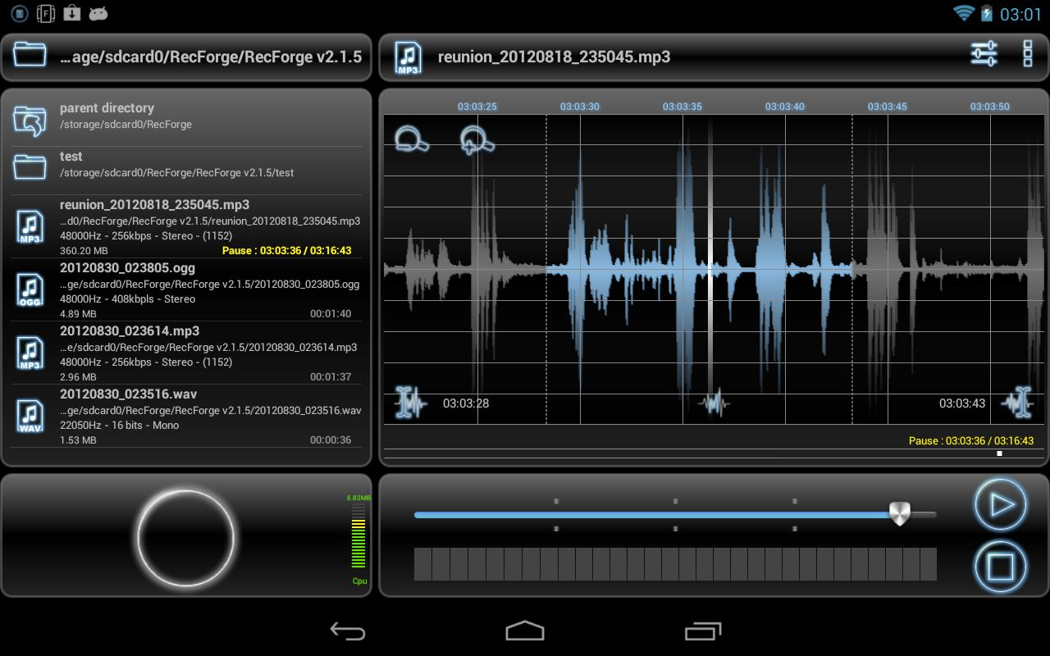
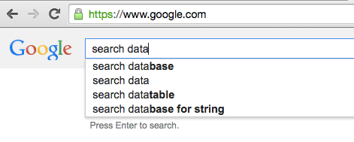
goal: use social data to gain insights into population behaviors and predict events in medicine, politics, crime and public health
Notes:
And, as I touched on before, our goal as the Institute is to combine social data and predictive analytics to predict events across a wide range of sectors.

Slide 12

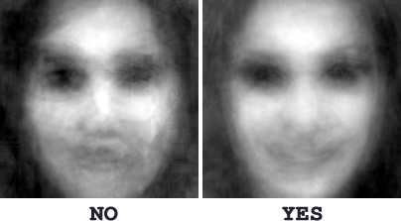
image recognition to predict abuse
Source: Tinder, Tinderbox blog
Notes:
Other projects we are interested in exploring make use of a different form of social data - image recognition. As I mentioned at the very beginning, over 70 million photos are posted on Instagram each day, and over 700 million -10x that number - of snaps on Snapchat. We are very interested in understanding how we might use image-recognition to recognize things like sexual or domestic abuse, and we are hoping to explore these areas further.

Slide 13
the hope intervention
Identify the role that social media can play in the HIV care continuum
Learn about the HOPE intervention
Describe how it is being adapted to address opioid abuse

Slide 14
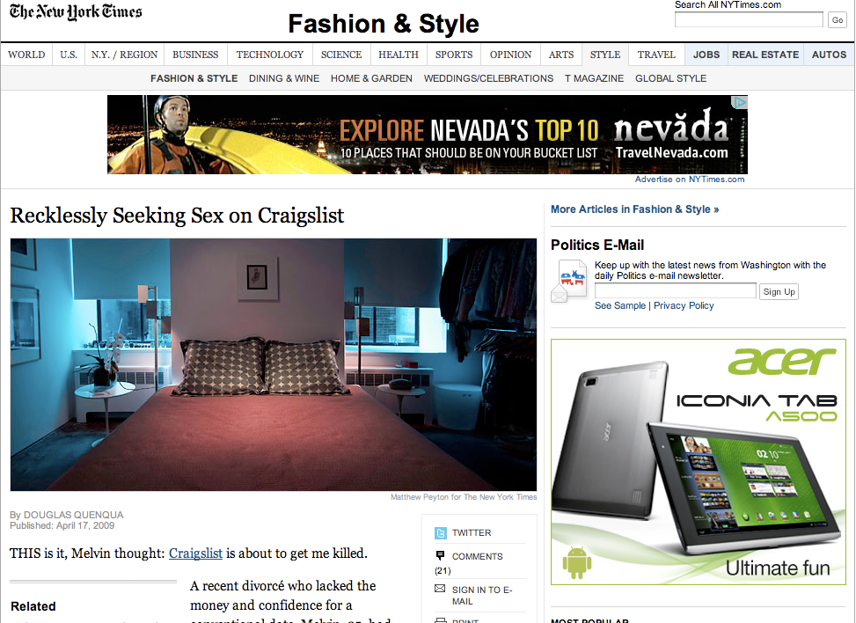

Slide 15
HIV/AIDs epidemiology
African Americans and Latinos in Los Angeles at high risk for HIV
Men who have sex with men (MSM) account for over 3/4 of all infections

Slide 16
Community-based hiv prevention methods
Community-based HIV prevention is powerful
Often make use of social networks and social connectedness, such as peer leader diffusion of innovations interventions
But it has limitations
Price
Access
Location/time
Stigma
Can social media be used to overcome the limitations?

Slide 17
reduce scientist-practitioner lag
Internet “sex seekers” at high-risk
Use modern methods of finding sex partners to reduce stigma
Craigslist
Dating sites
Social networking sites
Research, practice, and policy need to keep up to date with sex risk practices

Slide 18
benefits of social media technologies for hiv prevention
Social media/mobile technologies are designed for for social interaction
Allow users to:
befriend and find mutual friends
post and share pictures, videos, and other multi-media
have an online persona that can be publicly or privately available for other users
Access profiles from computers and cell phones
Research, practice, and policy need to keep up to date with sex risk practices
Notes:
Talk about important of “social”

Slide 19
digital divide is decreasing
2000-2010, African American/Latino Internet users increased from 11% - 21%
In California, 58% of Latinos access the Internet (63% of Californians)
Among Internet users,70% African Americans and English-speaking Latinos use social networking sites, 60% Whites
50% of African Americans visit OSN daily, 33% of Whites

Slide 20
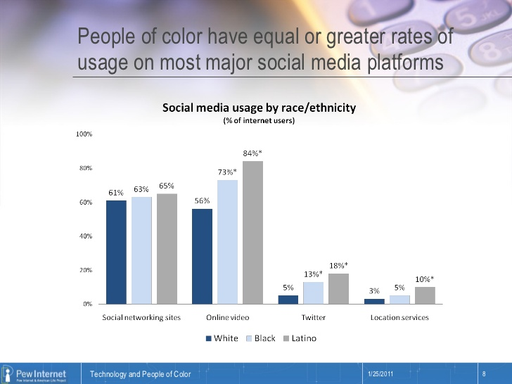

Slide 21
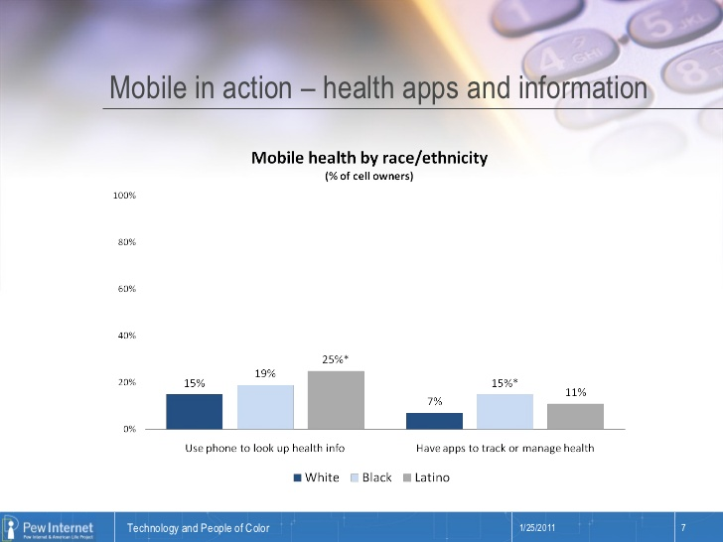

Slide 22
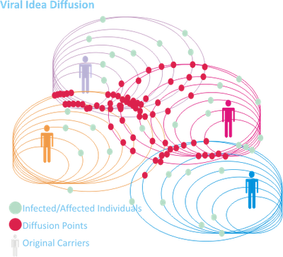

hope for hiv prevention and care
Using social media for HIV prevention/ sex education
Peer-Leader Diffusion Model

Slide 23
Intervention Methods
Control group Peer leaders discuss general health topics
Experimental Group Peer leaders discuss HIV education topics
Aims:
Home-based HIV testing
Self-reported sexual behaviors
Reduction in stigma

Slide 24






Peer leader recruitment plan
Partnering with Community Outreach
Fliers
Discussion Boards
Live Presentations

Slide 25
Recruitment sequence
Expressed Interest
Directed to Website
Pass Screening Process
Fail Screening Process
Sign Consent Form
Reject Consent Form
Sample:
122 Registered
Participants

Slide 26
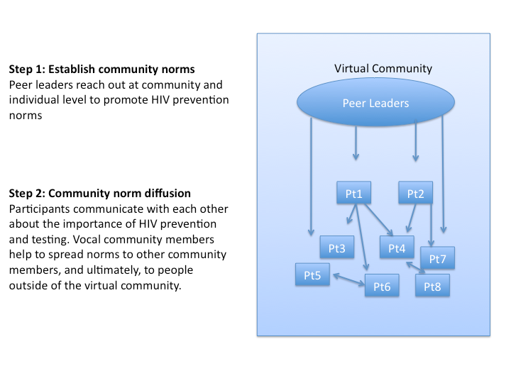

Slide 27
results
Retention rates were >90% at 12-week follow-up
Home-based HIV testing was an acceptable method of testing among these groups
Intervention differences¹⁰:
Increased home HIV testing requests
Decreased unprotected sex among intervention group participants
Initial results suggestion intervention diffusion
Among intervention group, increased network growth associated with HIV prevention
Established initial standards for use of social mHealth in HIV prevention research ¹¹

Slide 28
results
Feasible to recruit/train minority MSM peer leaders ^{1,2}
Feasible to recruit minority MSM participants ³
AA MSM less likely to engage in unprotected receptive anal intercourse compared to Latino MSM ⁴
Number of partners met on social networks associated with:
1) exchanged sex
2) number of new partners,
3) number of male sex partners,
4) frequency of engaging in oral sex ⁵

Slide 29
Results
High rates of stimulant drug use among the sample
> 1/3 used social networks to seek sex
more likely to have used methamphetamines in the past 12 months ⁶
Participants were highly engaged and shared personal information
HIV prevention discussions increased over study, demonstrating effectiveness
Conversation associated with > HIV testing requests
Social networking can be a tool for mixed (qualitative and quantitative) methods ^{7,8}

Slide 30
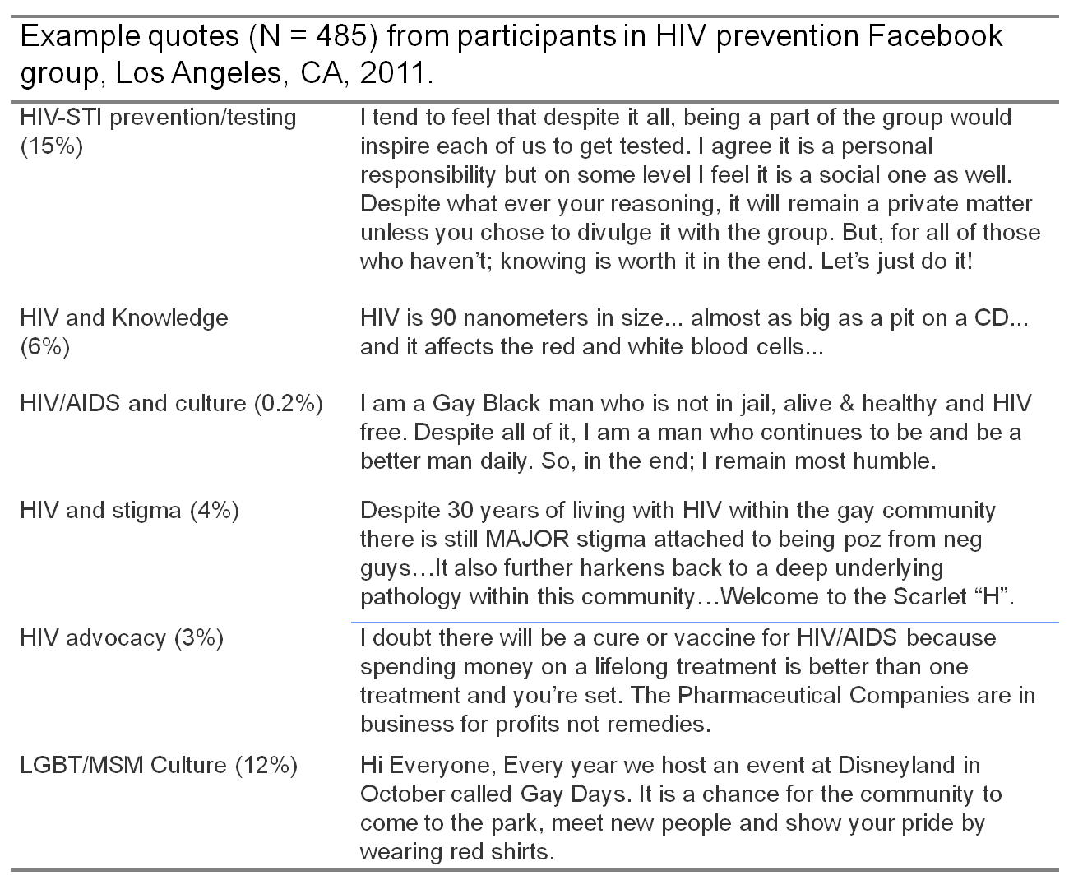

Slide 31
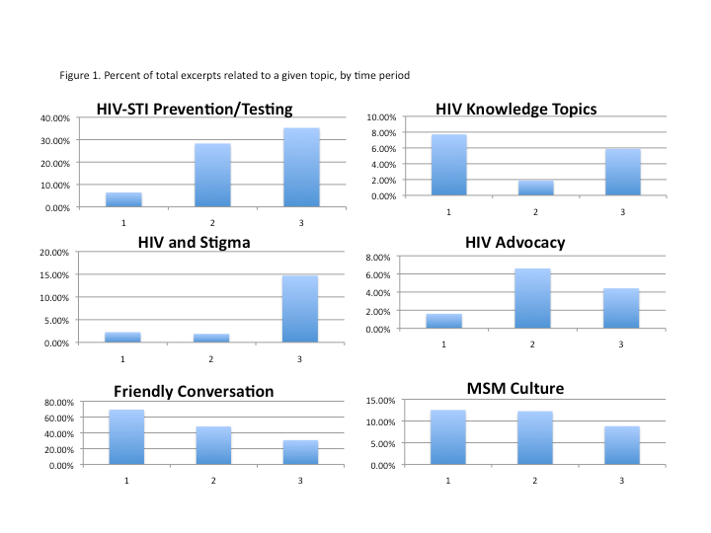

Slide 32
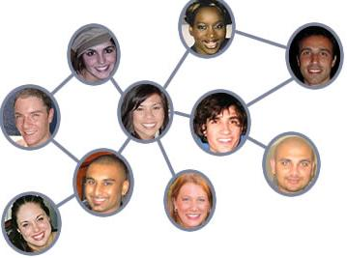

online social network diffusion
HOPE participants contacted friends
Friends completed a survey

Slide 33
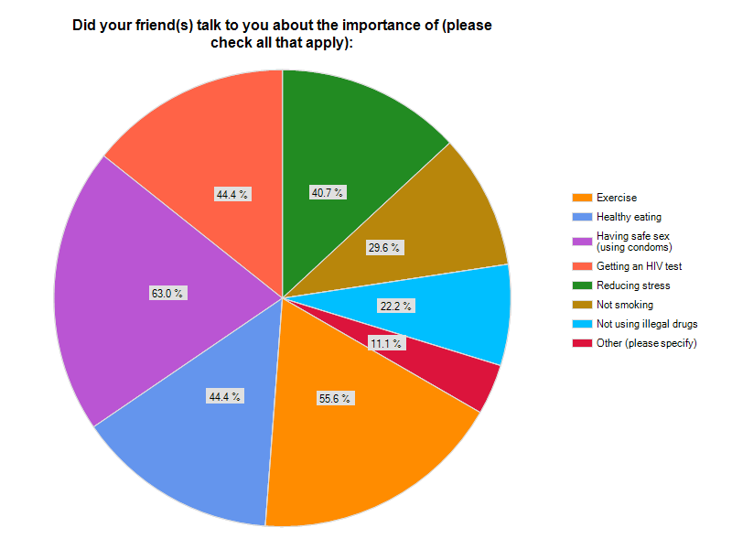

Slide 34
conclusion
Technologies increasingly being used for behavioral and mental health
HOPE is an example of an evidenced-based approach for applying new technologies
Chronic opioid therapy
Room for innovation and improvement in this growing area
Devices
Validity

Slide 35
BlackBoxPhd and
Community Education
About
Current Research

Slide 36

research • partnerships • sponsorships
Get involved
predictiontechnology.ucla.edu
@predictech
@seanyoungphd
Notes:
Again, I am Sean Young and I urge you to get involved by emailing, tweeting, instagramming, snapping, yakking or even just old-fashioned picking up the phone and giving us a call. Whatever your favorite method of getting in touch is, please spread the word about us and get involved. thanks so much!

